Slide 1
Important Note Regarding This Microsoft PowerPoint Presentation
* Do not include this slide in your presentation *
This slide deck has been intentionally provided with very limited graphics and formatting to simplify content integration into your own preferred PowerPoint themes and styles.

Slide 2
Security Development Lifecycle (SDL) Field Content
Threat Modeling Tool Principles
(Level 100)

Slide 3
Agenda
Overview of Microsoft SDL
Microsoft SDL Threat Modeling Tool overview
Benefits and features
Microsoft SDL Threat Modeling Tool steps:
Draw Diagrams
Analyze Model
Describe Environment
Generate Reports
Demonstration
Discussion forum

Slide 4

Microsoft Security Development Lifecycle (SDL)
Training
Requirem-ents
Design
Implemen-tation
Verification
Release
Response
Delivering secure software requires:
Executive commitment → SDL a mandatory policy at Microsoft since 2004
Education
Technology and Process
Accountability
Ongoing Process Improvements → 6 month cycle

Slide 5
Microsoft SDL Threat Modeling Tool Overview
Microsoft SDL Threat Modeling Tool: A graphical user interface tool that helps application designers create and analyze threat models, document mitigations and create actionable reports
Official Web site:
http://msdn.microsoft.com/en-us/security/dd206731.aspx
Microsoft SDL Threat Modeling tool requirements:
Microsoft Vista, Microsoft Server 2008 or higher
Microsoft Visio 2007 (see http://us20.trymicrosoftoffice.com/product.aspx?re_ms=oo&family=visioprofessional&culture=en-US) or higher

Slide 6
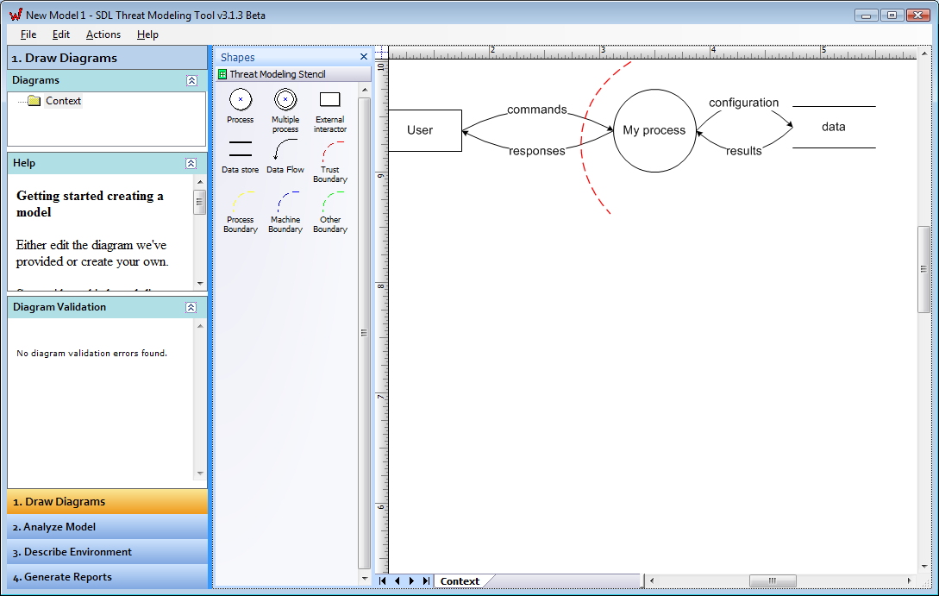
Microsoft SDL Threat Modeling Tool Benefits and Features
Vision
Process automation
Guided analysis of threats and mitigations (STRIDE)
Microsoft Visual Studio Team Foundation Server integration
Reporting capabilities
Step 1: Model
Step 2: Enumerate Threats
Step 3: Mitigate
Step 4: Validate
Product
Development

Slide 7
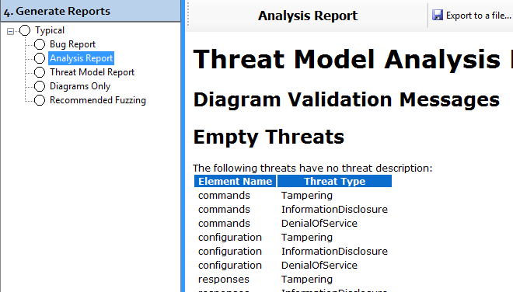
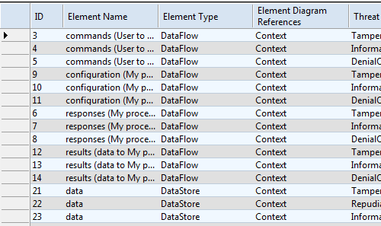
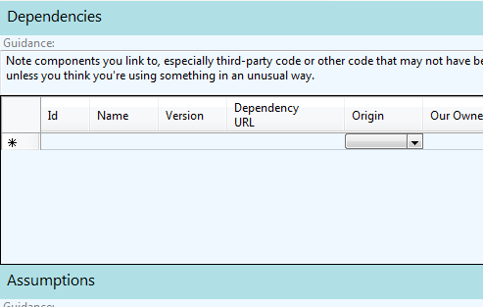
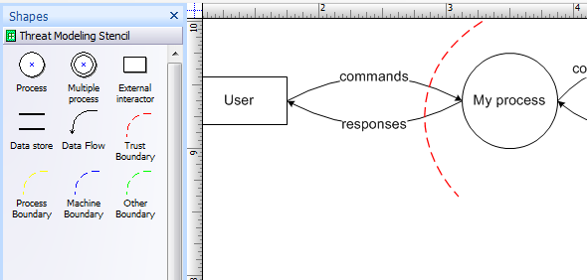
Using the Microsoft SDL Threat Modeling Tool
Four steps to using the Microsoft SDL Threat Modeling Tool:
Draw Diagrams
Analyze Model
Describe Environment
Generate Reports

Slide 8
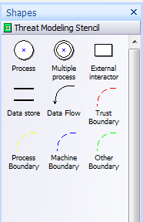
Step 1: Draw Diagrams
Step Objective: To model an application design as a data flow diagram to drive threat analysis

Slide 9
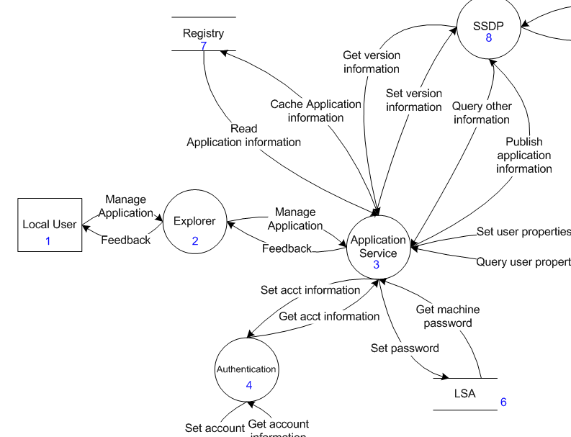
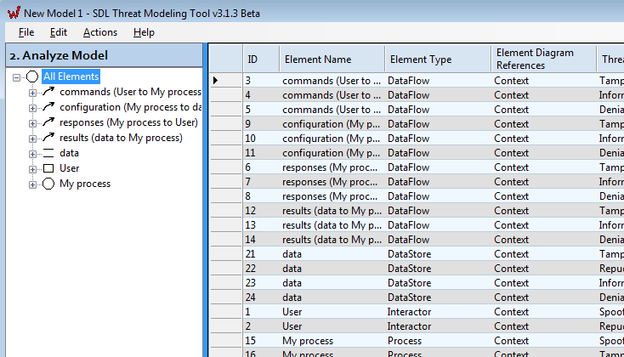
Step 2: Analyze Model
Step Objective: To identify a baseline set of potential threats and mitigations for each data flow diagram element in the threat model
T
M
S
M
E
M
STRIDE
R
M

Slide 10
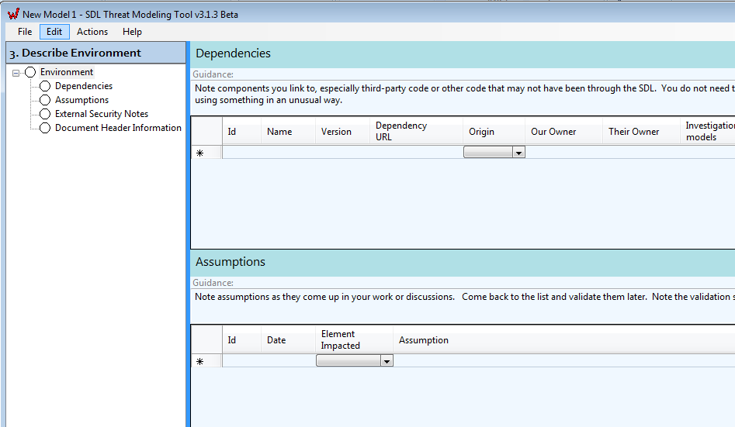
Step 3: Describe Environment
Step Objective: To describe the environment in which the application will be deployed

Slide 11
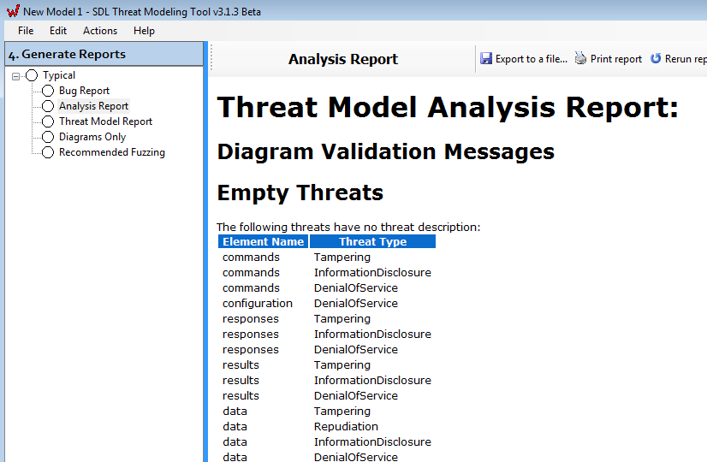
Step 4: Generate Report
Step Objective: To generate threat analysis and mitigation plan reports

Slide 12
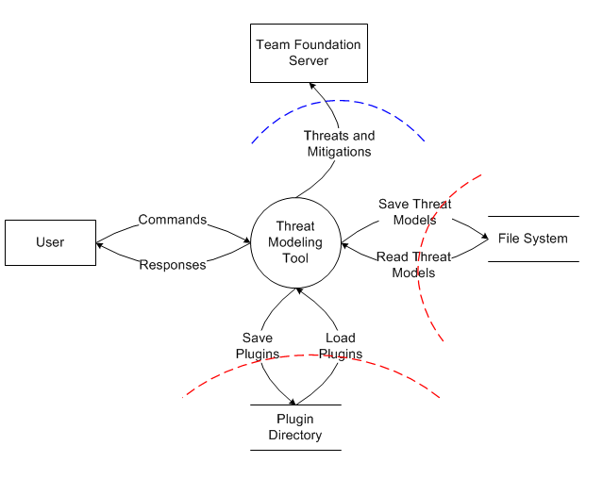

Microsoft SDL Threat Modeling Tool Demonstration
Team Foundation Server
D
M
R
M
Threat Modeling Tool
Saved Reports
T
M
Plugins

Slide 13
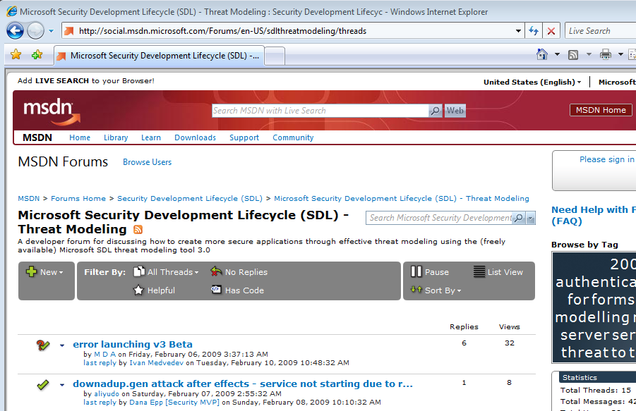


Microsoft SDL Threat Modeling Tool Discussion Forum
Q:
A:
SDL!
Discussion and issue reporting at:
http://social.msdn.microsoft.com/Forums/en-US/sdlthreatmodeling/threads

Slide 14
Conclusion
Overview of the Microsoft SDL Threat Modeling Tool
Benefits and features
Steps to use the Microsoft SDL Threat Modeling Tool
Microsoft SDL Threat Modeling Tool discussion forum

Slide 15
Appendix

Slide 16


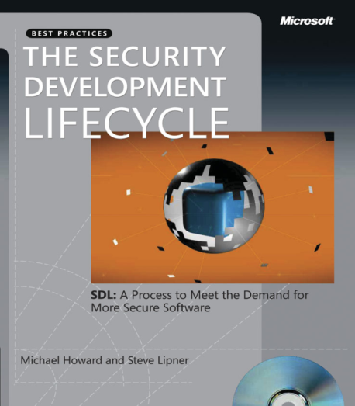


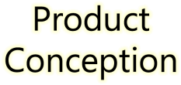















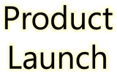







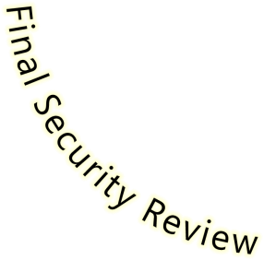
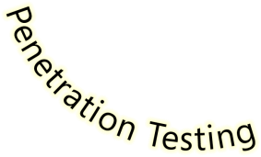

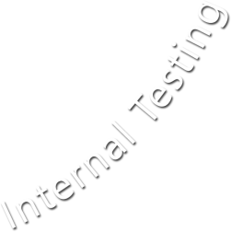





Microsoft Security Development Lifecycle (SDL)
SDL Book:
http://www.microsoft.com/mspress/books/8753.aspx
Official SDL Web Site: http://www.microsoft.com/sdl

Slide 17
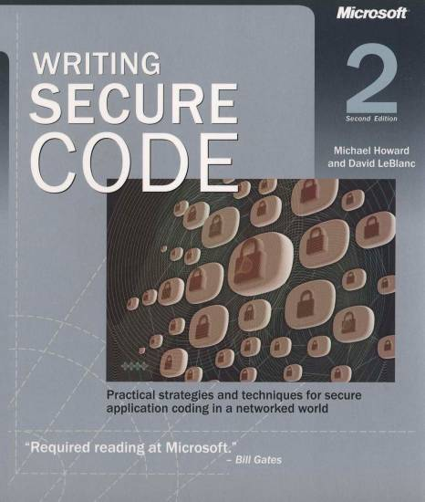
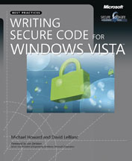
Microsoft Writing Secure Code Book Series
Writing Secure Code,
2nd Edition:
http://www.microsoft.com/mspress/books/5957.aspx
Writing Secure Code for Windows Vista:
http://www.microsoft.com/mspress/books/10723.aspx

Slide 18
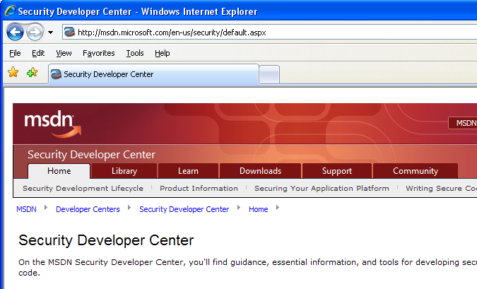

Microsoft Developer Network (MSDN) Security Developer Center
Official Web site: http://msdn.microsoft.com/security

Slide 19
Secure Development Blogs
The Microsoft Security Development Lifecycle (SDL) Blog: http://blogs.msdn.com/sdl
Michael Howard’s Blog: http://blogs.msdn.com/michael_howard

Slide 20
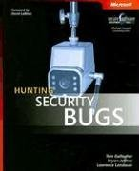
Microsoft Hunting Security Bugs
Hunting Security Bugs:
http://www.microsoft.com/mspress/books/8485.aspx

Slide 21
Additional SDL Training Content
Secure Design Principles
Secure Implementation Principles
Secure Verification Principles
SQL Injection Vulnerabilities
Cross-Site Scripting Vulnerabilities
Buffer Overflow Vulnerabilities

Slide 22
STRIDE Threat Types
Desired Property | Threat | Definition
Authentication | Spoofing | Impersonating something or someone else
Integrity | Tampering | Modifying code or data without authorization
Non-repudiation | Repudiation | The ability to claim to have not performed some action against an application
Confidentiality | Information Disclosure | The exposure of information to unauthorized users
Availability | Denial of Service | The ability to deny or degrade a service to legitimate users
Authorization | Elevation of Privilege | The ability of a user to elevate their privileges with an application without authorization

